Slide 1
What is cybercrime?
who are the victims, And what is the cost?
Michelle Helfman
5/15/2022

Slide 2
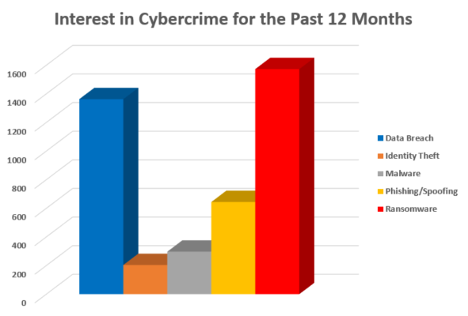
What is CyberCrime?
Cybercrime uses a computer, a network and/or the internet to attack and steal information to intentionally harm individuals, corporations, or governments.
Data Breach – Sensitive information is stolen from a secure location.
Malware – Software created to cause damage or gain access to a computer/network
Ransomware – Prevents you from accessing your information until a ransom is paid
Identity Theft – Theft of personal information then used to commit theft or fraud
Spoofing and Phishing – schemes to trick someone into providing sensitive information
Google Trends 5/16/2021 – 5/8/2022
Note – Hacking is a general term used to describe Data Breaches, Malware, Ransomware, Identity Theft, Phishing, Spoofing, and other forms of Cybercrime.

Slide 3
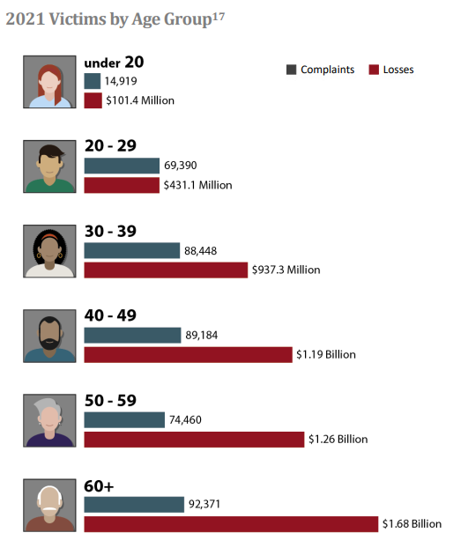
Victims OF CYBERCRIME
When an institution (banks, hospitals) or large business (Macy’s, Target) is hacked and has data stolen, recovery is quick, and the news runs a story about it 6 months later. When a person is a victim of cybercrime, they will spend months changing email addresses, user ids, and passwords, contacting creditors, and restoring their computers. At the cost of billions of dollars per year and most individuals never know they have been attacked. Most people over 50 do not have the technical knowledge making them particularly vulnerable to cybercrime.
FBI Internet Crime Report 2021

Slide 4
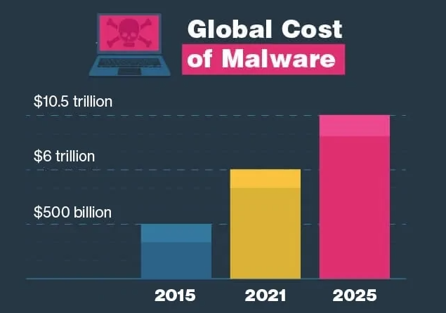
Types of Cybercrime – Malware
Malware (malicious software) was developed to steal data and damage or destroy computers and computer systems. In March 2022 over 8 million new malware programs were identified. This type of Cybercrime affects everyone resulting in ever-growing costs for businesses, institutions, and individuals.
38% of Malware is disguised as a Word document sent in emails.
Mobile malware targets older versions of Android phones.
24,000 malicious apps are blocked every day.
Hackers buy advertising space and send people to a webpage infected with malware.
SafetyDetectives

Slide 5
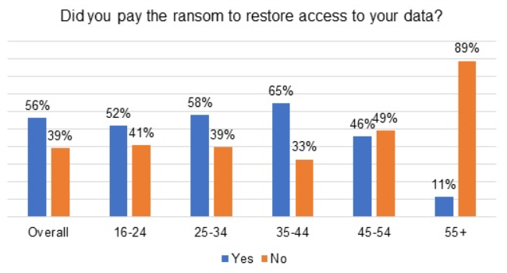
Types of Cybercrime – Ransomware
Ransomware is created to block access to computer systems using encryption until the money is paid. There is no guarantee the computer(s) will be released if the ransom is paid.
50% of victims paid the ransom, but only 25% of those who pay the ransom received their complete data in return.
Ransomware attacks increased 800% during the pandemic.
85% of attacks target windows systems.
In 2021, ransomware accounted for $50 million in lost revenue.
The average ransom is now over $6,000.
Kaspersky

Slide 6
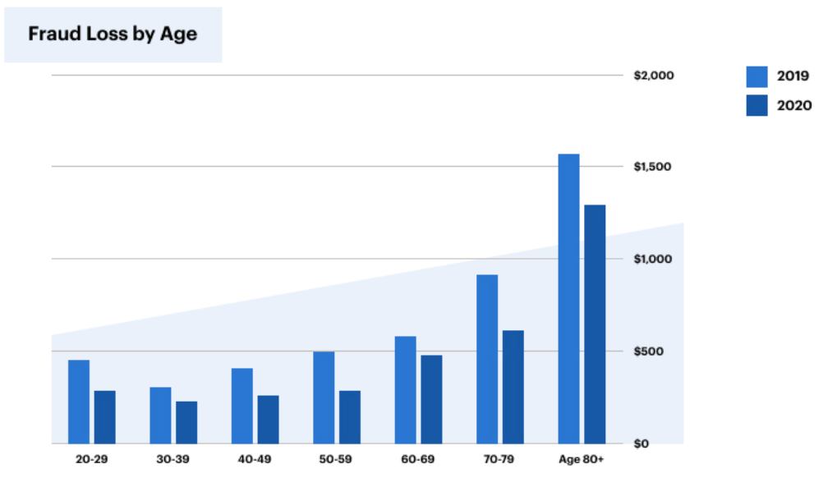
Types of Cybercrime – Identity Theft
Identity Theft is when someone steals and uses personal identification, like a name or Social Security or driver's license number, without permission to commit fraud or other crimes. The cybercriminal uses this account information to take over the victim's accounts, apply for credit cards, make purchases, draining bank accounts, essentially taking over their lives.
Children and Seniors are at most risk of Identity Theft.
Losses tied to child ID fraud average $737 per family.
Identity thieves can use your medical insurance or steal your tax refund
Fake identities can be created and used, if arrested.
After assuming your identity, thieves can transfer the title of your home and sell it.
It can take years to restore credit, return stolen money and property, and prove fraudulent purchases.
ConsumerAffairs.com

Slide 7
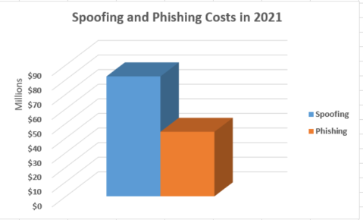
Types of Cybercrime – Spoofing and Phishing
Phishing uses unsolicited email, text messages, and telephone calls purportedly from a legitimate company requesting personal, financial, and login credentials. Spoofing is email addresses, and phone numbers that appear legitimate used to make mass rob calls and send mass emails. Both are used in connection with other crime types.
Spoofed emails look like they come from family members asking for favors or money.
Spoofing has affected the stock market by appearing to increase demand.
Phishing emails send you to realistic looking websites where you are tricked into entering your personal information.
FBI Internet Crime Report 2021

Slide 8
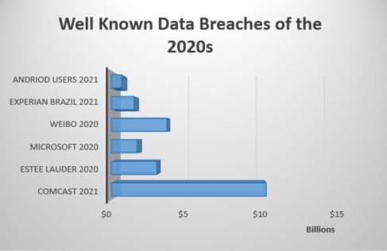
Types of Cybercrime – Data Breach
Data Breaches affect everyone; sensitive information is stolen from an institution, business, or personal devices. Data breaches are profitable for hackers seeking personally identifiable information to steal money, compromise identities, or sell over the dark web. They are a costly expense that can damage lives and reputations and take time to repair.
Data Breaches are caused by out-of-date software or security flaws creating holes for malware to sneak on computers, phishing scams getting someone to reveal their ID/Password, and realistic emails containing links to malicious websites.
In 2020 the average cost of a data breach was $8.64 million.
Hackers can be in a business’s computers for weeks, months, even years before being discovered.
Compensation from companies and institutions may only be credit monitoring for a year.
Betanews

Slide 9
CONCLUSION
If you have never been a victim of cybercrime, you know a victim of cybercrime. There are stories in the news about ransomware and data breaches. Employers send emails to trick/train you to spot phishing and spoofing. Corporation have training classes in cybercrime, but what can a person do to protect themselves.
Keep your software (especially security software) up to date. Scan your computer for viruses and malware regularly.
Create strong passwords.
Don’t overshare on social media; it might give away answers to security questions.
Talk to your children about the acceptable use of internet and managing personal questions.
Monitor your credit, bank accounts, and online presence.
Compare email addresses with the sender’s name and check for spelling anomalies.
Never follow links inside emails to sites where you need to provide personal information, go directly to those sites only if you are familiar with them.

Slide 10
References
Internet Crime Report 2021 (n.d.) Federal Bureau of Investigation
https://www.ic3.gov/Media/PDF/AnnualReport/2021_IC3Report.pdf
Google Trends. (n.d.). [Interest in Cybercrime]. Retrieved May 15, 2022 Part 1 & Part 2
https://trends.google.com/trends/explore?geo=US&gprop=news&q=%2Fm%2F03c18t5,%2Fm%2F018npy,%2Fm%2F0582c,%2Fm%2F027b9k,%2Fm%2F0657nv
https://trends.google.com/trends/explore?geo=US&gprop=news&q=spoofing
Sanders, Andrew (n.d) 15 (CRAZY) Malware and Virus Statistics, Trends & Facts
https://www.safetydetectives.com/blog/malware-statistics/
Over half of ransomware victims pay the ransom, but only a quarter see their full data returned
(March 30, 2021) Kaspersky
https://www.kaspersky.com/about/press-releases/2021_over-half-of-ransomware-victims-pay-the-ransom-but-only-a-quarter-see-their-full-data-returned
C., Eric (n.d) Ransomware Facts, Trends & Statistics for 2022
https://www.safetydetectives.com/blog/ransomware-statistics/
Lawson, Lori (February 25, 2022) 2021 Identity theft statistic
https://www.consumeraffairs.com/finance/identity-theft-statistics.html
What To Know About Identity Theft (n.d.) Federal Trade Commission
https://consumer.ftc.gov/articles/what-know-about-identity-theft
Scams and Safety (n.d.) Federal Bureau of Investigation
https://www.fbi.gov/scams-and-safety/common-scams-and-crimes/spoofing-and-phishing
Baker, Ian (February 21, 2022) The most expensive data breaches of the 2020s
https://betanews.com/2022/02/21/the-most-expensive-data-breaches-of-the-2020s/
Johansen, Allison Grace (March 10, 2020) What is a data breach?
https://us.norton.com/internetsecurity-privacy-data-breaches-what-you-need-to-know.html

